Slide 2
Focus Question 7.1
Compare and contrast the 1980 eruption of Mount St. Helens with the most recent eruption of Kilauea, which began in 1983.

Slide 3
Mount St. Helens Versus Kilauea
Mount St. Helens
Largest historic eruption in North America
Lowered peak by more than 400 m
Destroyed all trees in a 400 km² area
Mudflows 29 km down Toutle River
Ejected 1 km³ ash more than 18 km into stratosphere

Slide 4
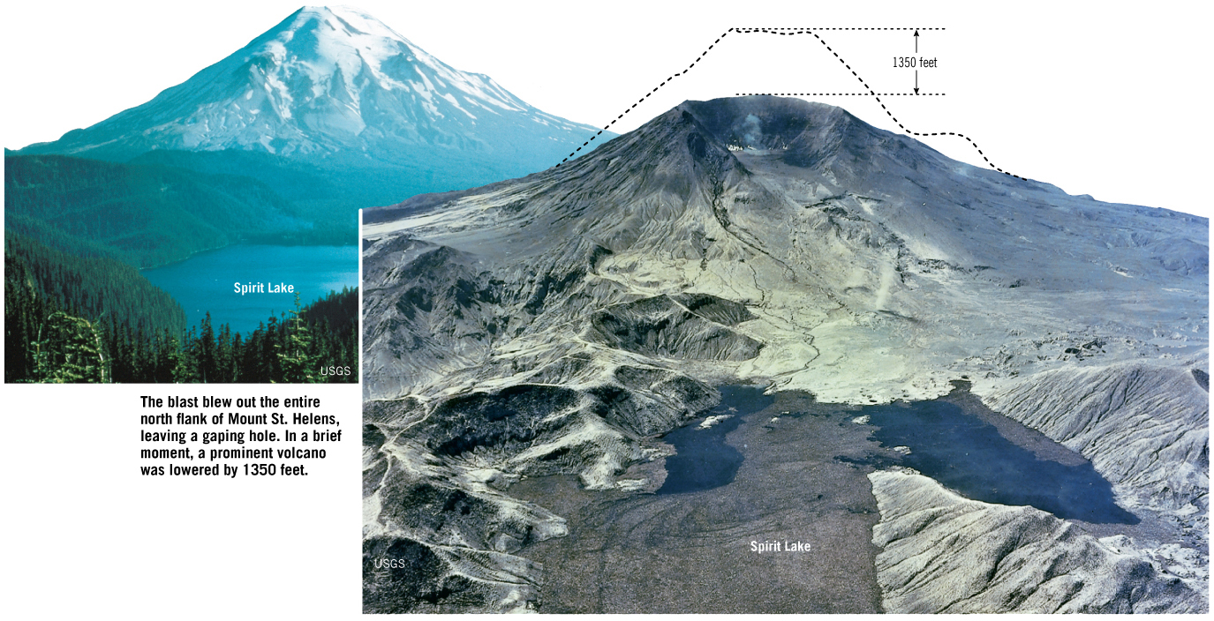
Mount St. Helens Versus Kilauea

Slide 5
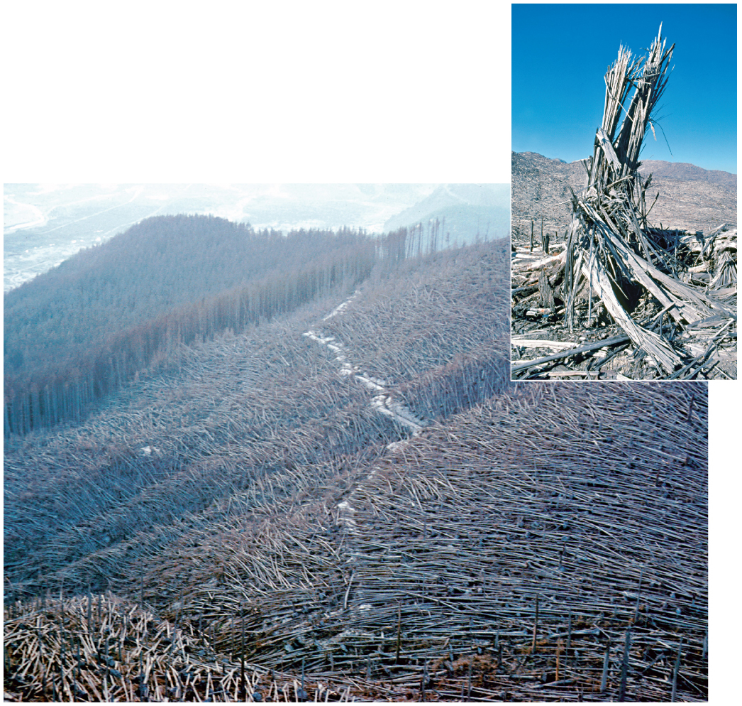
Mount St. Helens Versus Kilauea

Slide 6
Mount St. Helens Versus Kilauea
Kilauea
Quiet eruption of fluid basaltic lava
Occasional lava sprays
Eruption began in 1983 and has been ongoing for more than 20 years

Slide 7
Focus Question 7.2
Explain why some volcanic eruptions are explosive and others are quiescent.

Slide 8
Magma: Source Material for Volcanic Eruptions
Magma
Molten rock containing crystals and dissolved gas
Lava
Erupted magma
Basaltic magma
Generated by partial melting in upper mantle
At oceanic crust, erupts as highly fluid lava
At continental crust, collects at crust−mantle boundary
Partial melting of overlying continental crust generates dense, silica-rich magma

Slide 9
Quiescent Versus Explosive Eruptions
Viscosity
Resistance to flow
How to decrease magma viscosity
Increase temperature
Decrease silica content
Rhyolitic magma (>70% Si) forms short, thick flows
Basaltic magma (~50% Si) is fluid
Gas content also dictates nature of eruption
Directly related to composition
Most common gas is water vapor

Slide 10
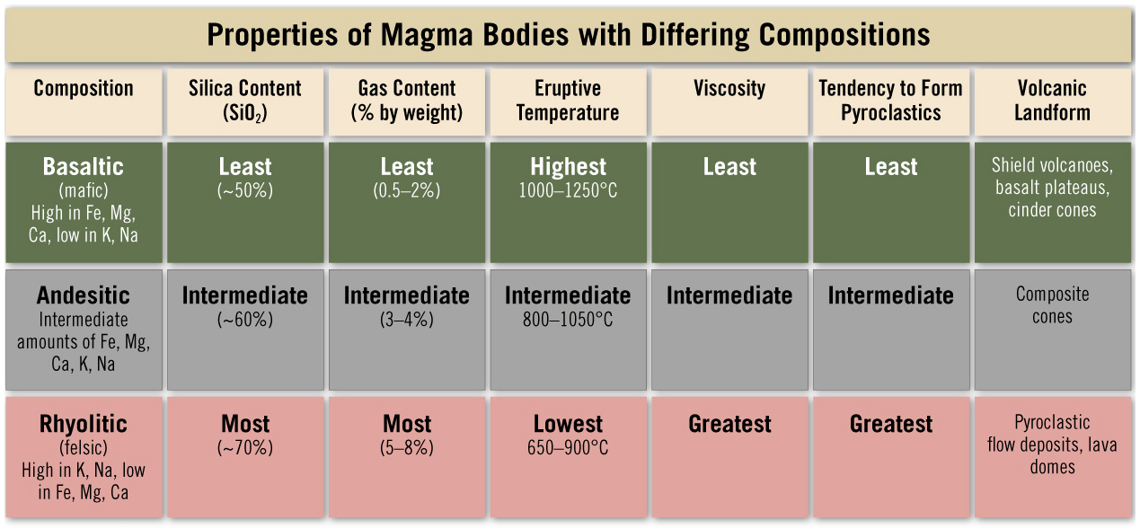
The Nature of Volcanic Eruptions

Slide 11
Quiescent Hawaiian-Type Eruptions
Triggered by addition of magma to near-surface magma chamber
Inflation and fracture of volcano summit
Fluid basaltic lava
Ongoing eruption of Kilauea since 1983

Slide 12
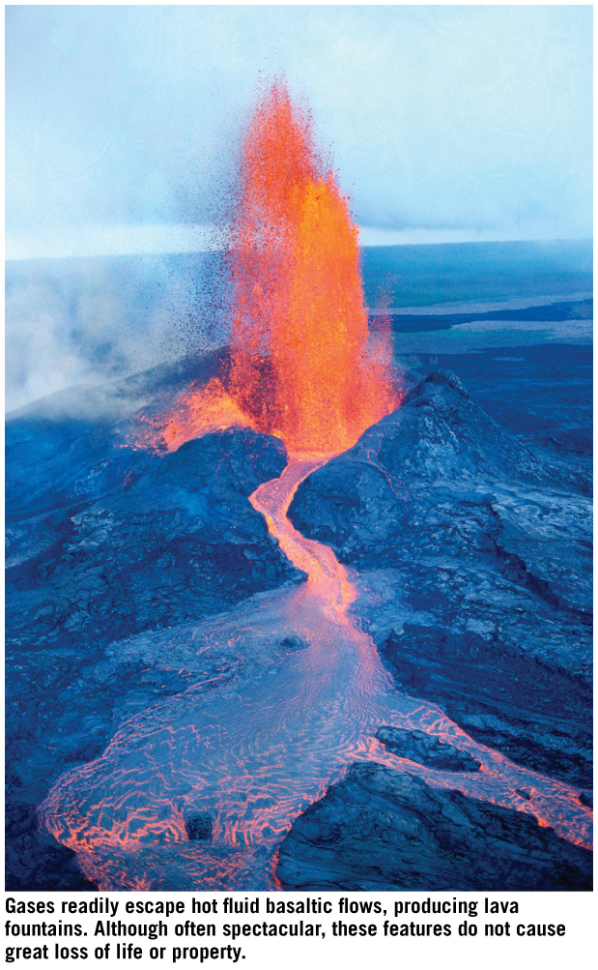
Quiescent Hawaiian-Type Eruptions

Slide 13
How Explosive Eruptions Are Triggered
Pressure decreases as magma rises
Dissolved gas forms expanding bubbles
Viscous magma expels fragmented lava and gas
Buoyant plumes of material (eruption columns)
Rapid ejection of magma
Reduces pressure in magma chamber
Causes further expansion and eruption

Slide 14
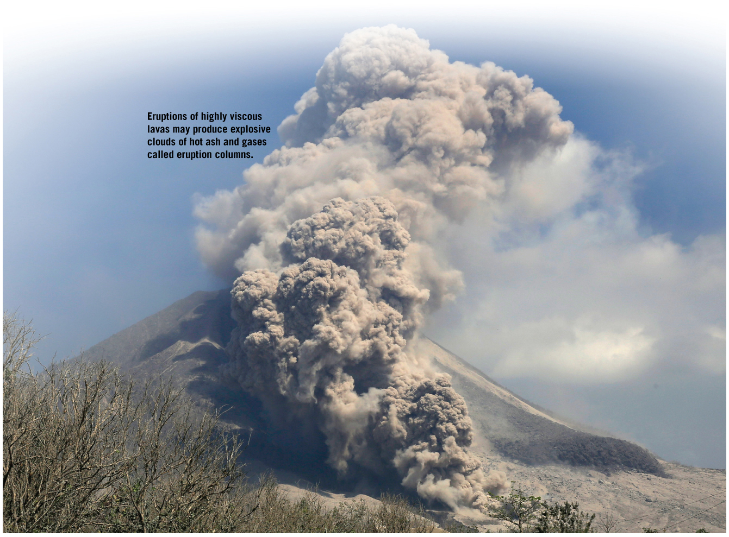
How Explosive Eruptions Are Triggered

Slide 15
Focus Question 7.3
List and describe the three categories of materials extruded during volcanic eruptions.

Slide 16
Lava Flows
90% of lava is basaltic
Most is erupted on seafloor (submarine volcanism)
Flows in thin, broad sheets or ribbons
Flow rate ~10 to 300 m/hr
Up to 30 km/hr downhill
~9% is andesitic/intermediate
<1% is rhyolitic
Thick flows move imperceptibly slow
Don’t flow beyond a few km from vents

Slide 17
Lava Flows
Two types of basaltic lava flows:
Aa
Rough, jagged blocks with sharp edges
Cooler, more viscous basaltic flows
Pahoehoe
Smooth, ropy surfaces
Hotter, less viscous basaltic flows

Slide 18
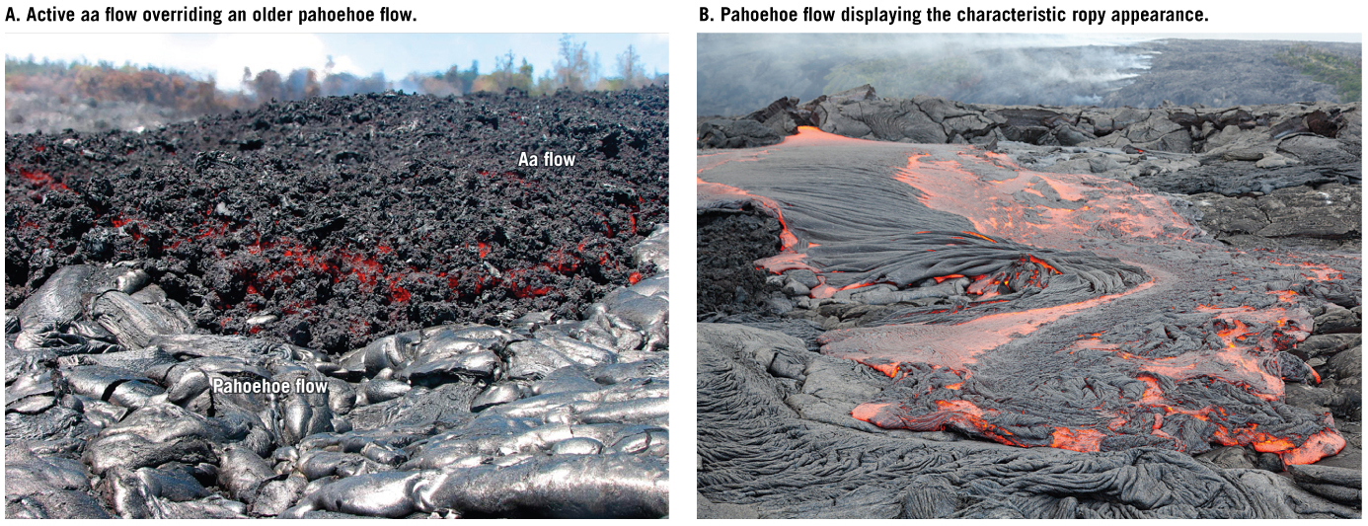
Lava Flows

Slide 19
Lava Flows
Lava tubes
Insulated pathways of a lava flow
Pillow lavas
Numerous tube-like structures stacked atop each other
Form on the ocean floor

Slide 20
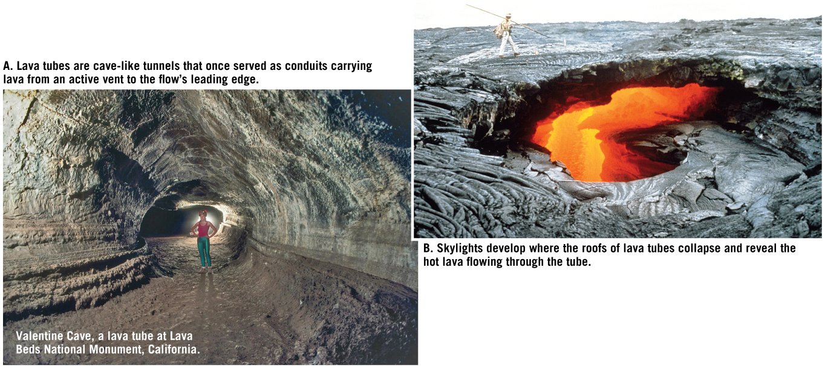
Lava Flows

Slide 21
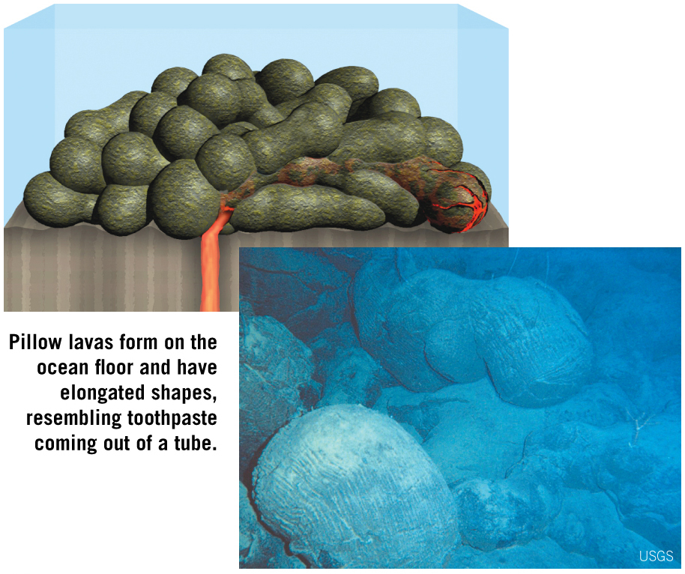
Lava Flows

Slide 22
Gases
Gases in magma are volatiles
Dissolved into magma because of confining pressure
~1–8% of total magma volume
Most abundant gases (in decreasing order): water vapor, carbon dioxide, sulfur dioxide, lesser amounts of hydrogen sulfide, carbon monoxide, and helium
Contribute to atmosphere
Significant quantities can alter global climate

Slide 23
Pyroclastic Materials
Pyroclastic materials or tephra
Particles erupted from a volcano (ash and dust)
Hot ash fuses to form welded tuff
Lapilli and cinders are the size of small beads to walnuts
Blocks are larger than 64 mm
Bombs are streamlined blocks ejected while still molten
Scoria is vesicular ejecta
Pumice is felsic equivalent

Slide 24
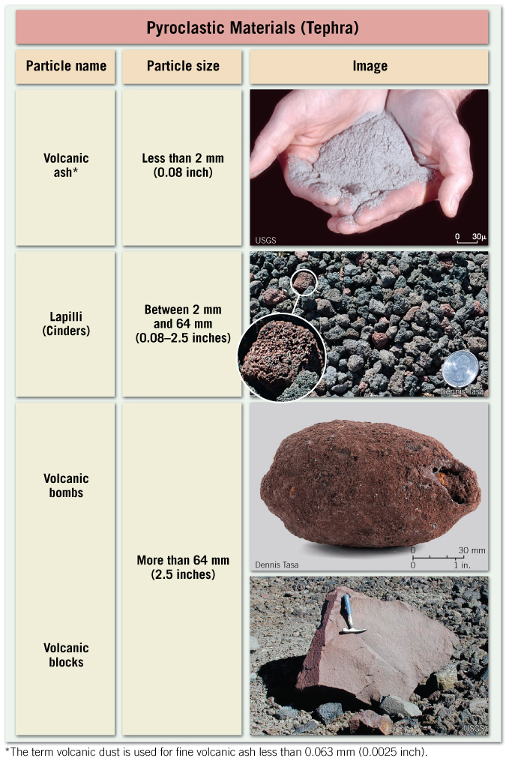
Materials Extruded During an Eruption

Slide 25
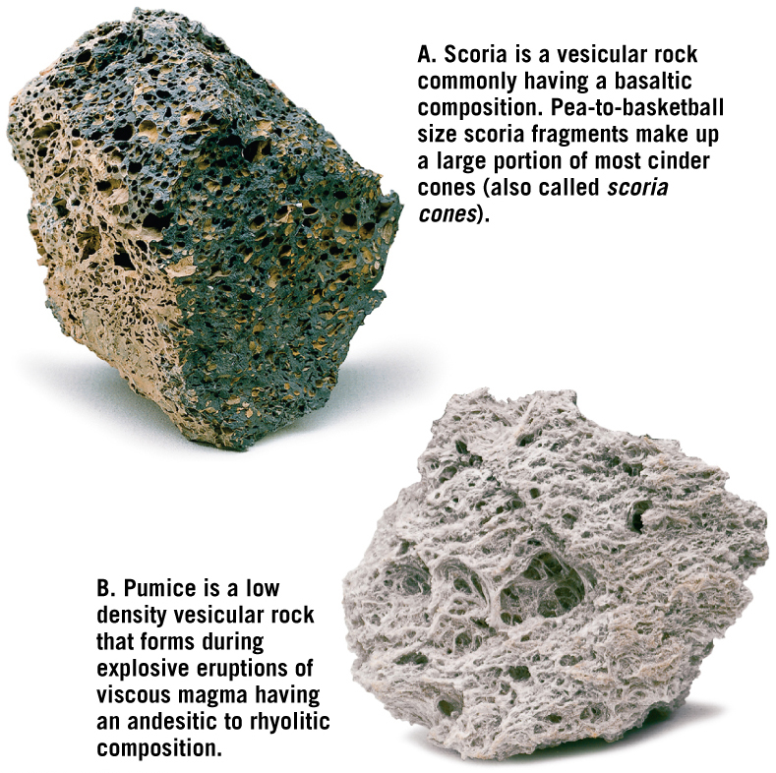
Materials Extruded During an Eruption

Slide 26
Focus Question 7.4
Draw and label a diagram that illustrates the basic features of a typical volcanic cone.

Slide 27
Anatomy of a Volcano
Volcanic landforms are the result of many generations of volcanic activity
Eruptions start at a fissure
Flow is localized into a circular conduit
Conduit terminates at a vent
Successive eruptions form a volcanic cone

Slide 28
Anatomy of a Volcano
Crater
Funnel-shaped depression at the summit
Form by erosion during, or collapse following, eruptions
Calderas are craters >1 km
Flank eruptions generate parasitic cones
Secondary vents that emit gas only are called fumaroles

Slide 29
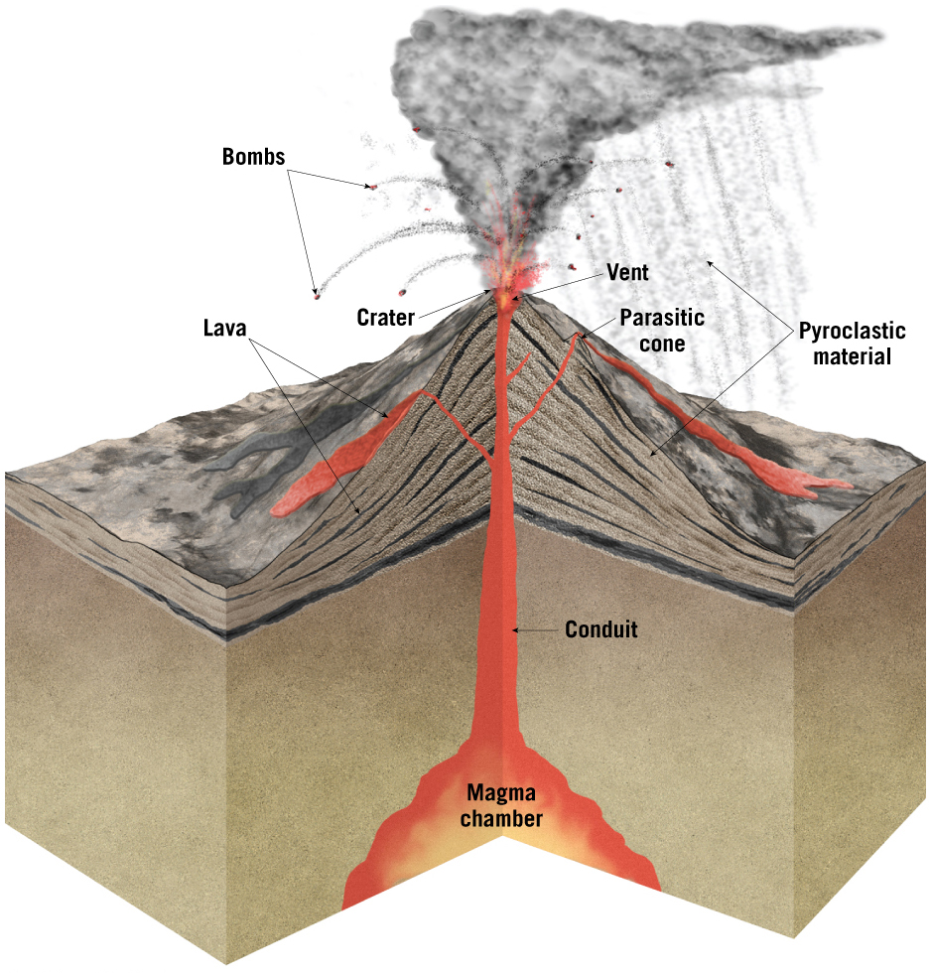
Anatomy of a Volcano

Slide 30
Focus Questions 7.5
Summarize the characteristics of shield volcanoes.
Provide one example of this type of volcano.

Slide 31
Shield Volcanoes
Broad domed structures built by accumulation of basaltic lava
Most begin as seamounts (submarine volcano)
e.g., Canary Islands, Hawaiian Islands, Galapagos, Easter Island, Newberry Volcano in Oregon

Slide 32
Mauna Loa: Earth’s Largest Shield Volcano
9 km high
Low angle slopes
Well-developed caldera from collapse of magma chamber following eruption

Slide 33
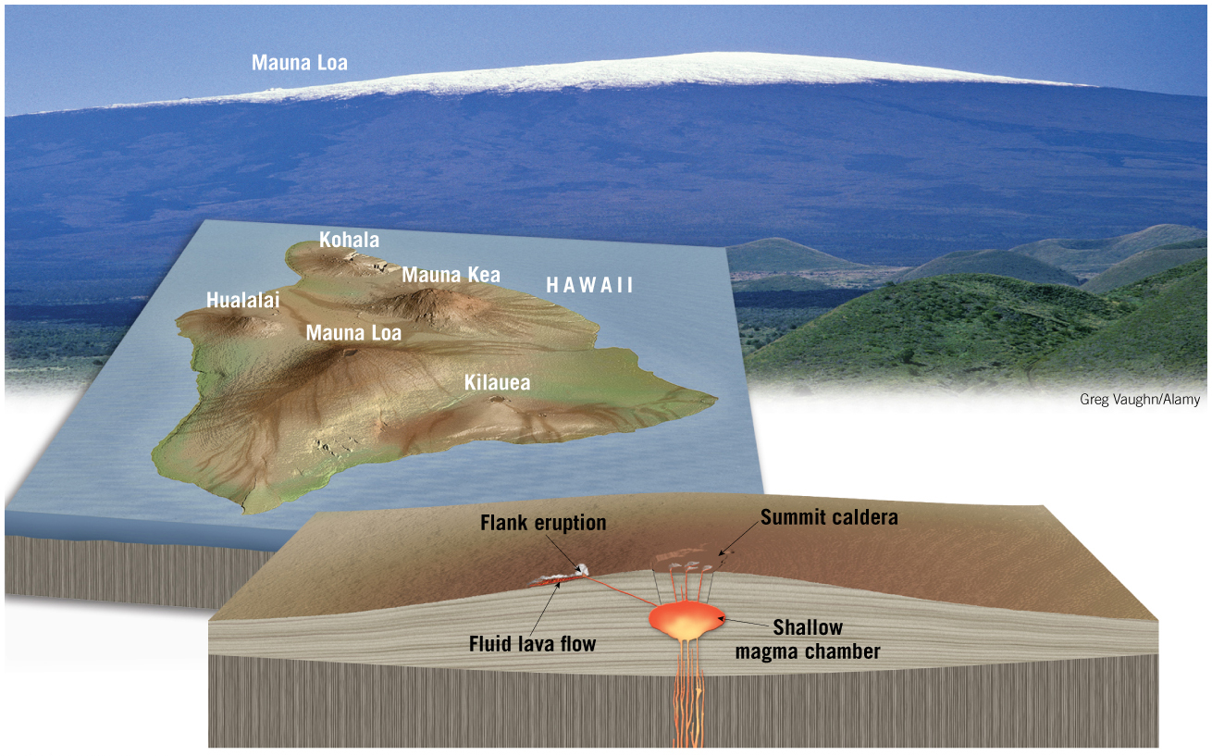
Mauna Loa: Earth’s Largest Shield Volcano

Slide 34
Kilauea: Hawaii’s Most Active Volcano
Kilauea is most active and studied volcano
50 eruptions since 1823
Most recent began in 1983
Magma chamber inflates and earthquake swarms indicate an impending eruption

Slide 35
Kilauea: Hawaii’s Most Active Volcano

Slide 36
Shield Volcanoes

Slide 37
Focus Question 7.6
Describe the formation, size, and composition of cinder cones.

Slide 38
Cinder Cones
Cinder cones (scoria cones)
Symmetrical
Steep-sided
Loose accumulations of ejected scoria
Commonly pea- to walnut-sized fragments
Basaltic composition, reddish-brown color
Some produce lava flows
Craters are relatively large and deep

Slide 39
Cinder Cones
Cinder cones form quickly
Many in less than one month
Generally in a single eruptive event
Small size (30–300 m)

Slide 40
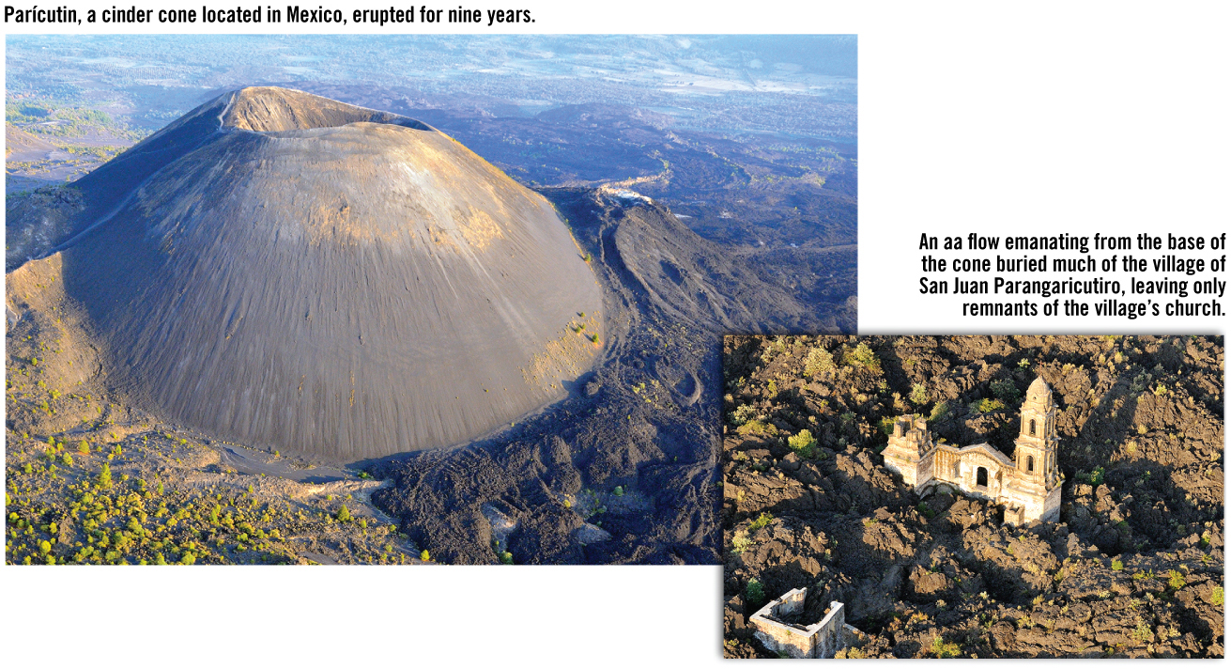
Cinder Cones

Slide 41
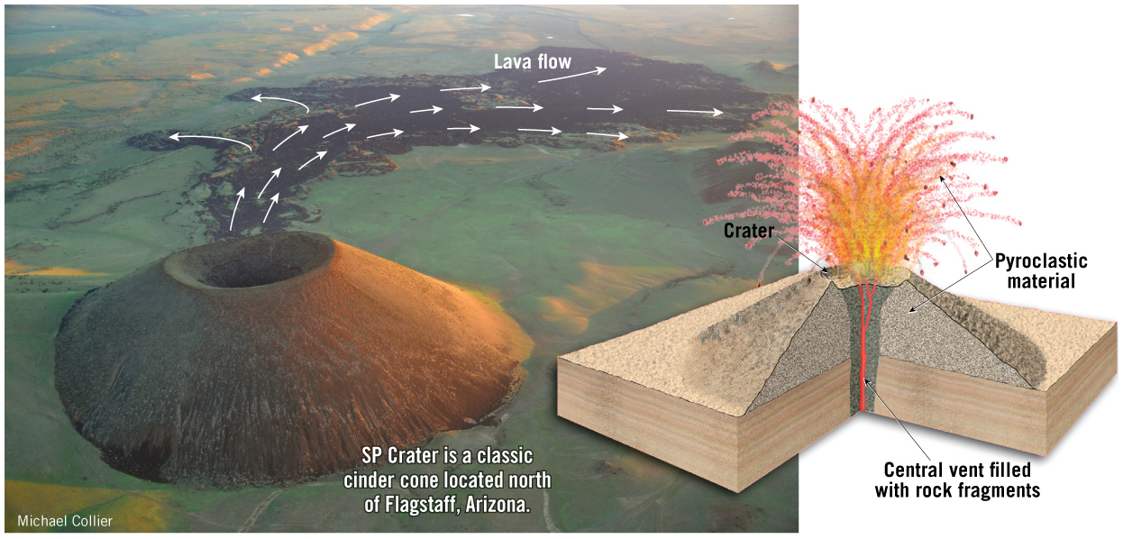
Cinder Cones

Slide 42
Focus Questions 7.7
List the characteristics of composite volcanoes.
Describe how these volcanoes form.

Slide 43
Composite Volcanoes
Composite cones or stratovolcanoes
Located around the Ring of Fire
Large, symmetrical cones
Built by layers of cinder and ash alternating with lava flows
Primarily silica-rich andesitic magma
Associated with explosive eruptions and abundant pyroclastic material
Steep summit and gradually sloping flanks

Slide 44
Composite Volcanoes

Slide 45
Focus Question 7.8
Describe the major geologic hazards associated with volcanoes.

Slide 46
Volcanic Hazards
70 volcanic eruptions expected each year
One large-volume eruption each decade
500 million people live near active volcanoes
Volcanic hazards include:
Pyroclastic flows
Lahars
Lava flows
Ash and volcanic gasses

Slide 47
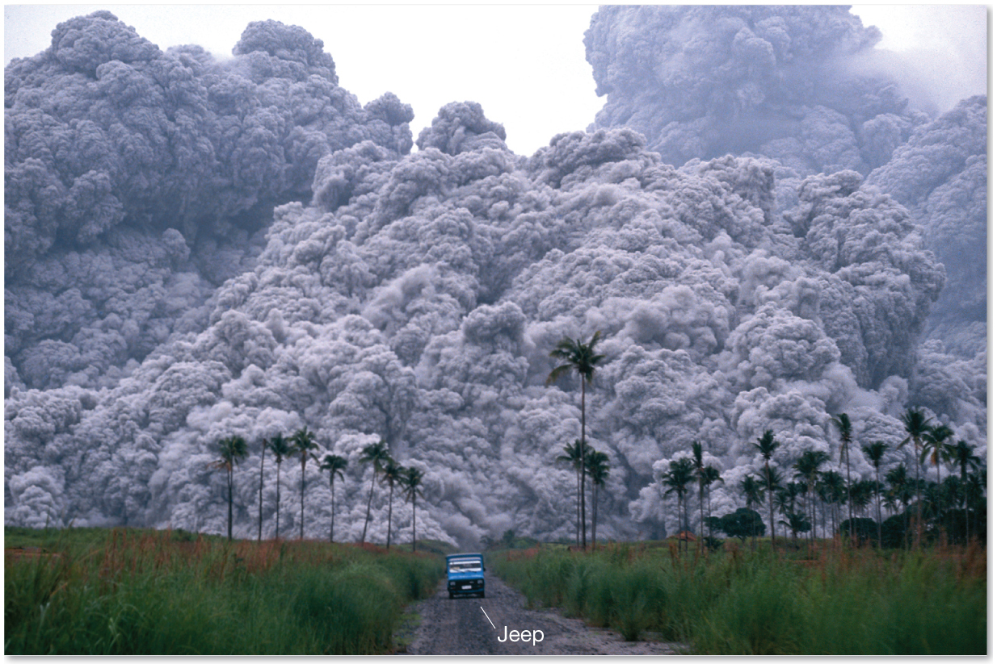
Volcanic Hazards

Slide 48
Pyroclastic Flow: A Deadly Force of Nature
Pyroclastic flow (nuee ardente)
Hot volcanic gas infused in incandescent ash and lava fragments
Gravity driven, can move up to 100 km/hr
Low-density cloud of hot gases and fine ash on top of layer of vesicular pyroclastic material
Caused by collapse of eruption columns

Slide 49
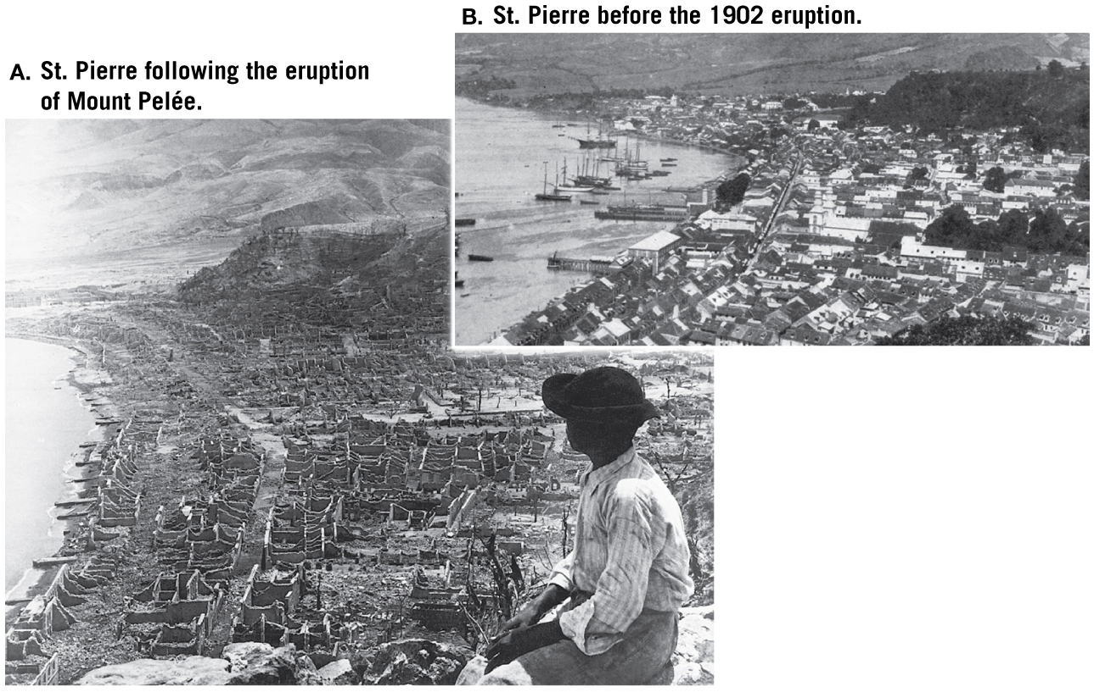
Volcanic Hazards

Slide 50
Lahars: Mudflows on Active and Inactive Cones
Lahars
Fluid mudflows
Water-saturated volcanic debris move down steep volcanic slopes
Can occur on dormant/extinct volcanoes

Slide 51
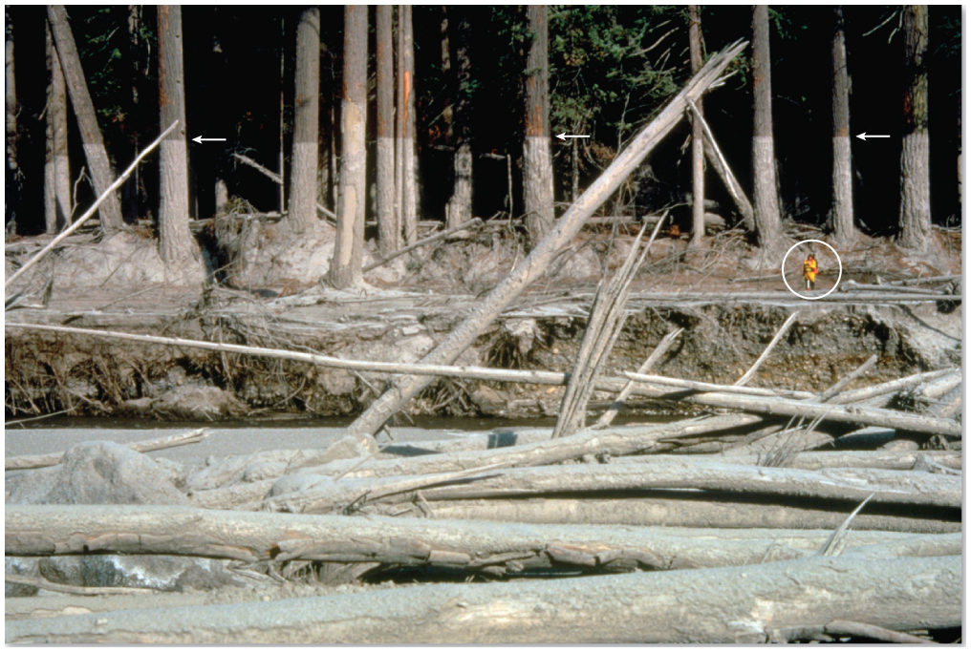
Lahars: Mudflows on Active and Inactive Cones

Slide 52
Other Volcanic Hazards
Tsunamis
Caused by collapse of volcano flanks into the ocean
Ash
Can damage buildings, living things, aircraft engines
Sulfur dioxide
Affects air quality and creates acid rain
Atmospheric cooling
Ash and aerosols reflect solar energy

Slide 53
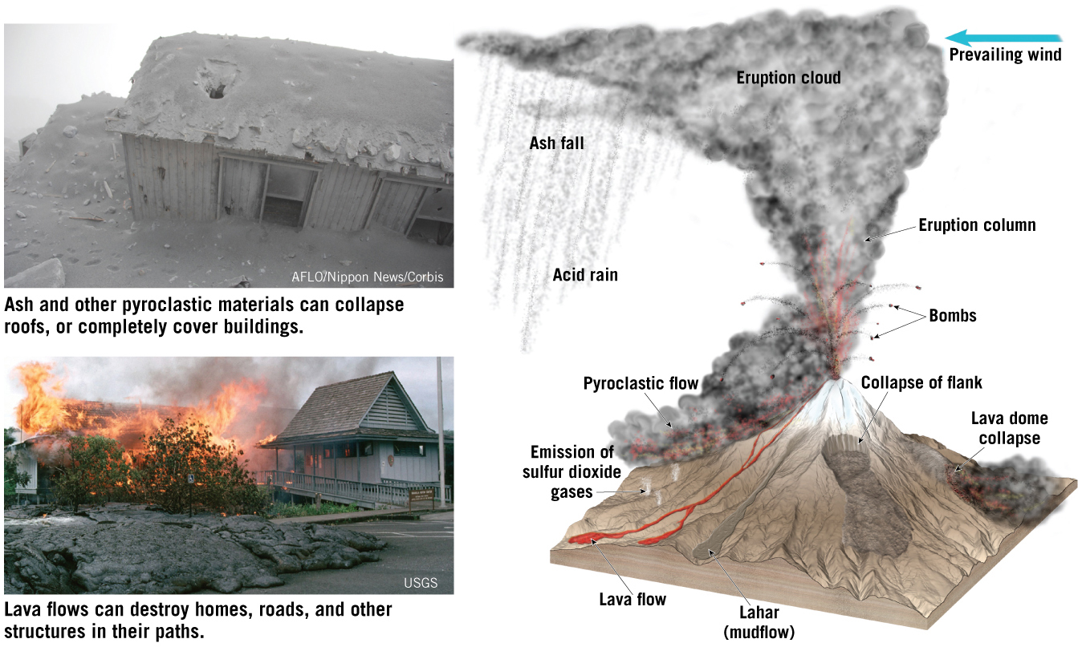
Volcanic Hazards

Slide 54
Focus Questions 7.9
List volcanic landforms other than shield, cinder, and composite volcanoes.
Describe their formation.

Slide 55
Other Volcanic Landforms
Caldera
Steep-sided crater less than 1 km in diameter
Formed by summit collapse following draining of the magma chamber

Slide 56
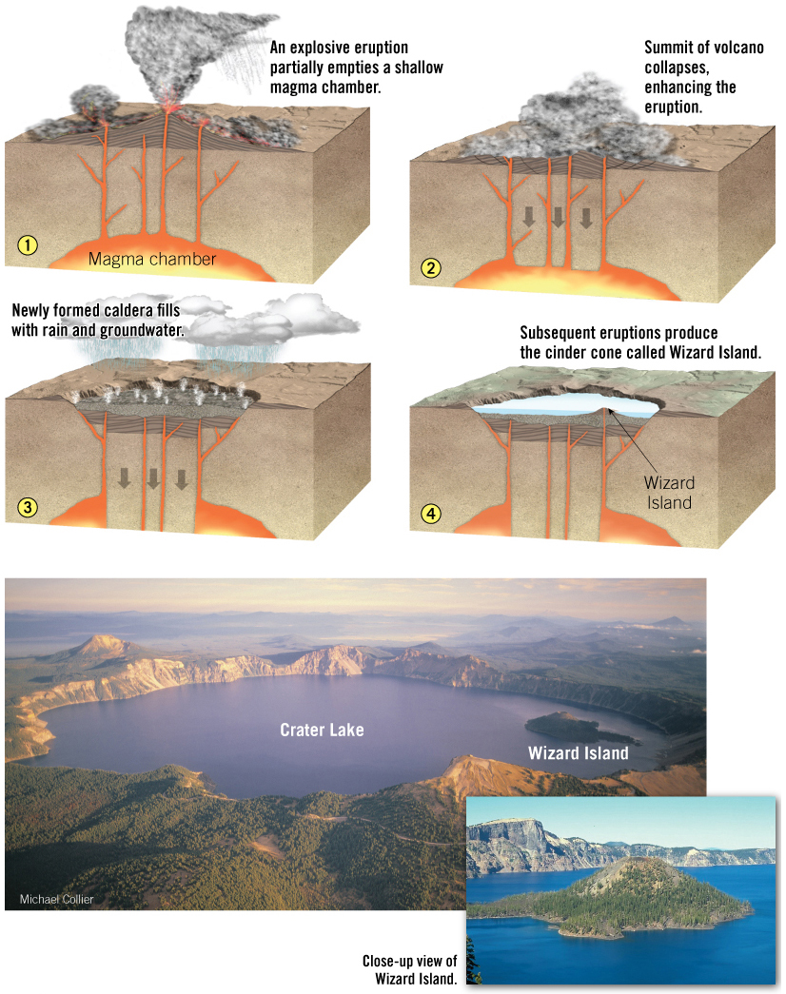
Other Volcanic Landforms

Slide 57
Other Volcanic Landforms
Fissure eruptions
Emit basaltic lavas from fissures (fractures)
Basalt plateaus
Flat, broad accumulations of basalt emitted from fissures
Flood basalts
Molten lava having flowed long distances within a basalt plateau

Slide 58
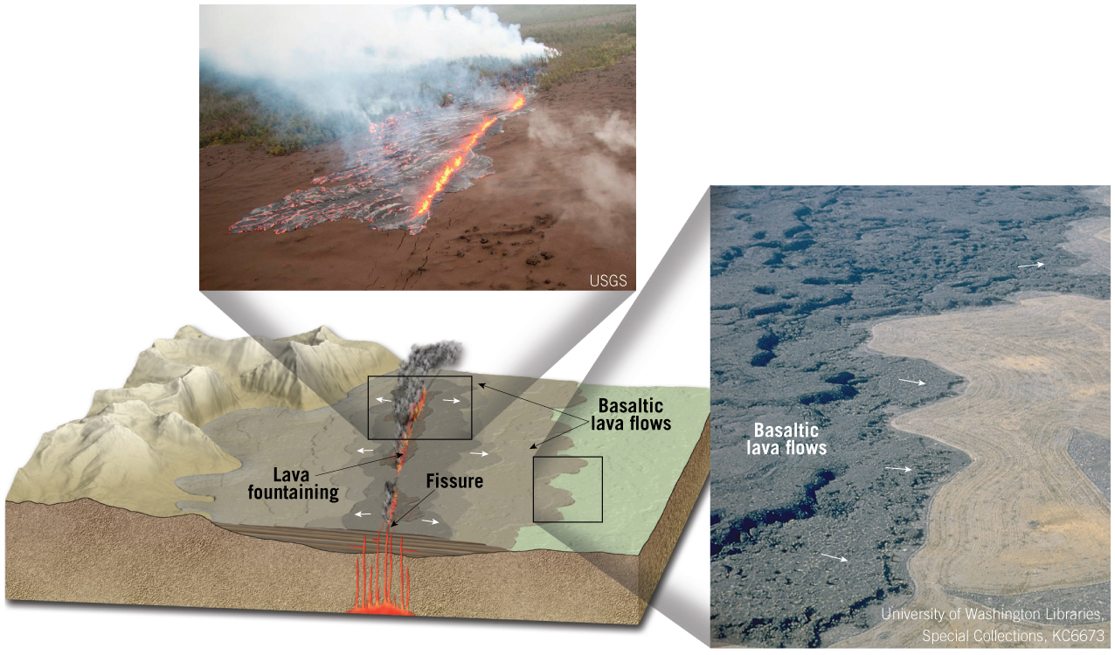
Other Volcanic Landforms

Slide 59
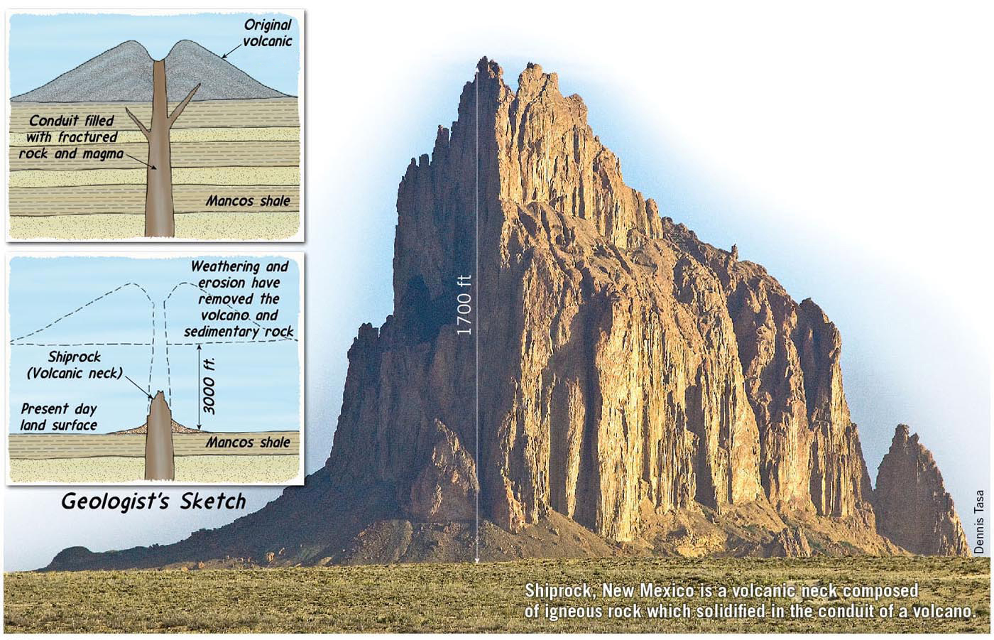
Other Volcanic Landforms
Volcanic necks (plugs)
Eroded volcanic cones expose the solidified magma inside the conduit

Slide 60
Focus Question 7.10
Compare and contrast these intrusive igneous structures:
Dikes.
Sills.
Batholiths.
Stocks.
Laccoliths.

Slide 61
Intrusive Igneous Activity
Magma that crystallizes in Earth’s crust displacing host or country rock forms intrusions or plutons
Exposed by uplift and erosion
Classified according to shape
Tabular or massive
May cut across existing structures
Discordant
Or inject parallel to features
Concordant

Slide 62
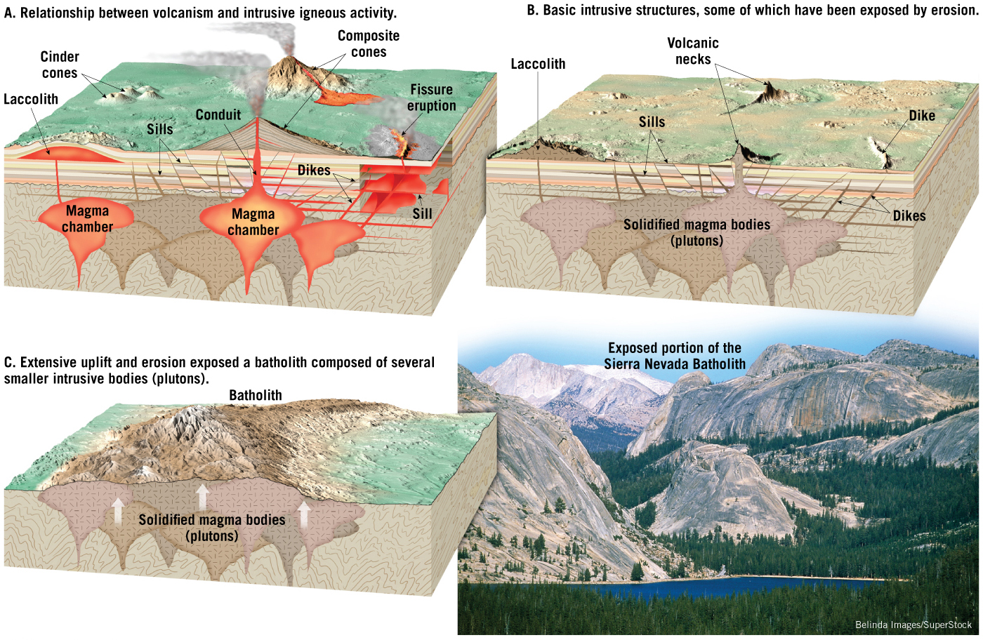
Intrusive Igneous Activity

Slide 63
Intrusive Igneous Activity
Tabular intrusive bodies
Magma is injected into a fracture or other zone of weakness
Dikes are discordant
Sills are concordant

Slide 64
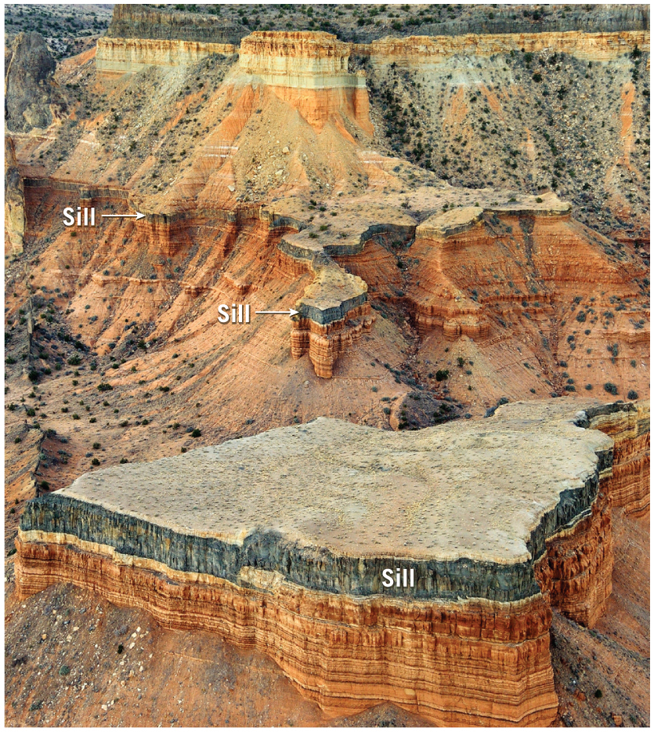
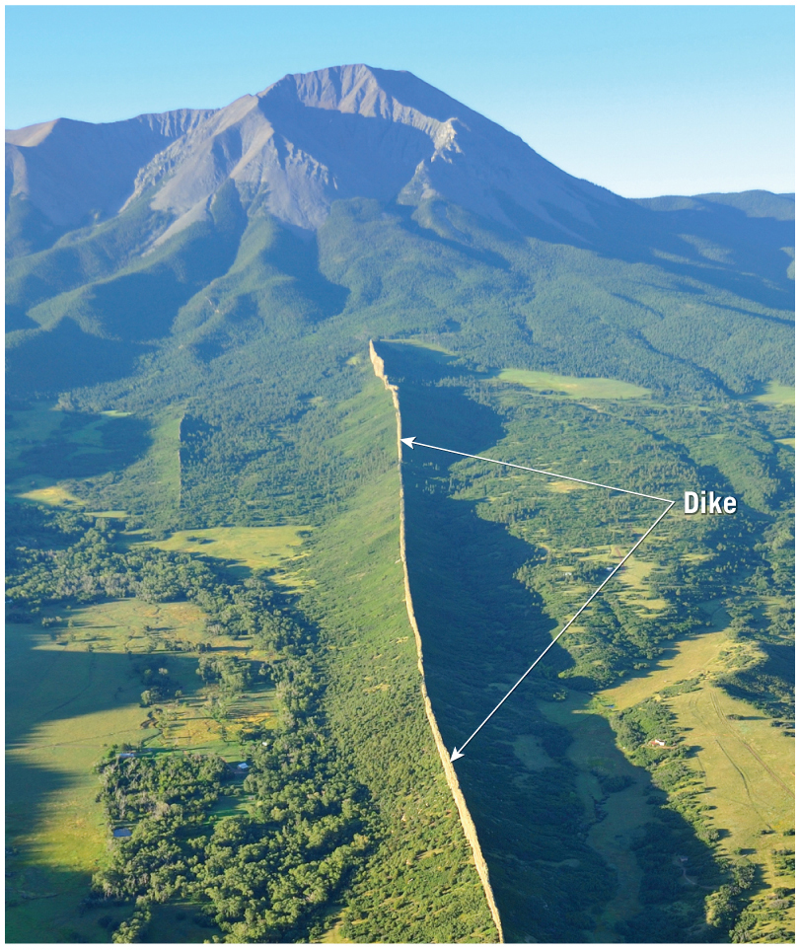
Intrusive Igneous Activity

Slide 65
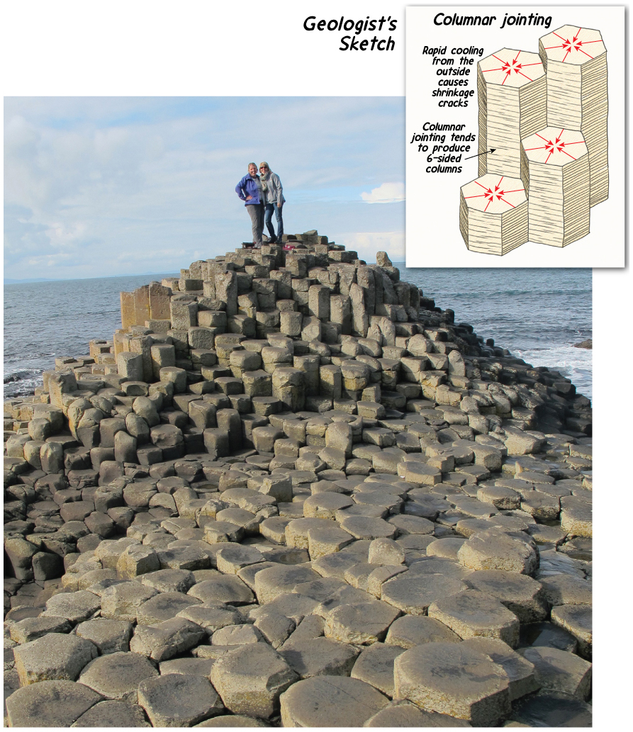
Intrusive Igneous Activity
Columnar jointing occurs as a result of shrinkage fractures that develop when igneous rocks cool

Slide 66
Intrusive Igneous Activity
Large intrusive bodies include:
Batholiths
Linear masses of felsic rocks hundreds of km long
Stocks
Surface exposure <100 km²
Laccoliths
Lift the sedimentary strata that they penetrate

Slide 67
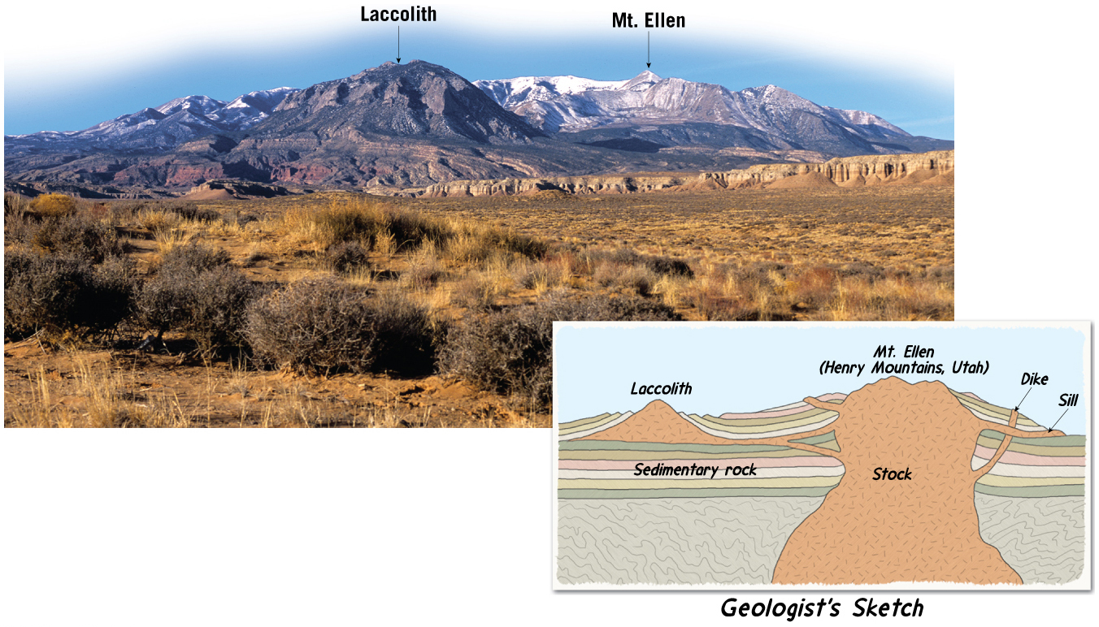
Intrusive Igneous Activity

Slide 68
Focus Question 7.11
Summarize the major processes that generate magma from solid rock.

Slide 69
Partial Melting
Earth’s crust and mantle are composed primarily of solid rock
Rock is composed of a variety of minerals with different melting points
Rocks melt over a range of temperatures
Incomplete melting of rocks is partial melting

Slide 70
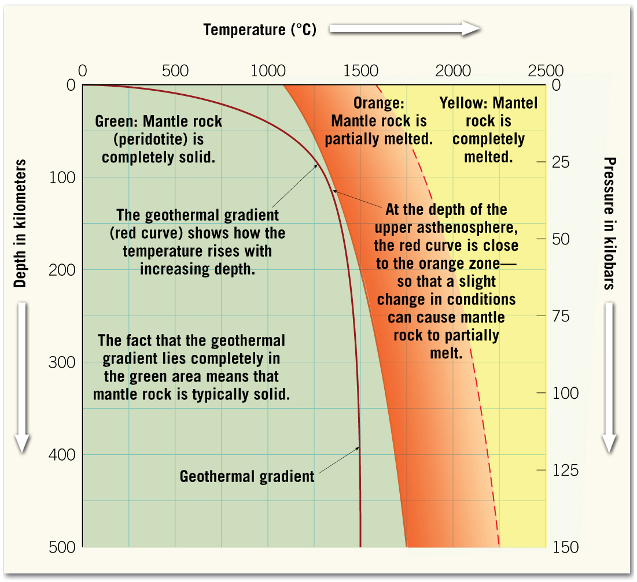
Partial Melting

Slide 71
Generating Magma from Solid Rock
Geothermal gradient averages ~25°C/km
Mantle is solid under normal conditions
Pressure increases melting temperature
Decompression melting is triggered when confining pressure decreases
Occurs at oceanic ridges

Slide 72
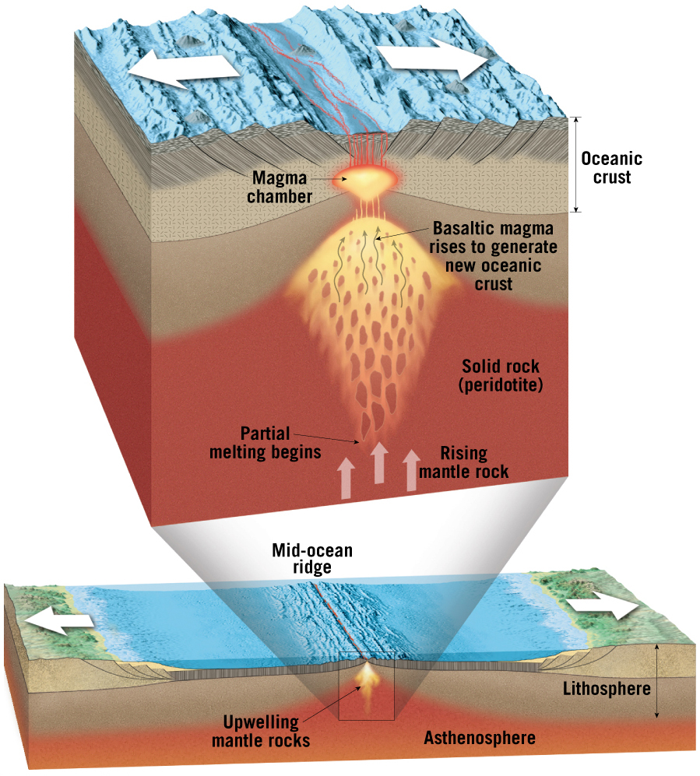
Generating Magma from Solid Rock

Slide 73
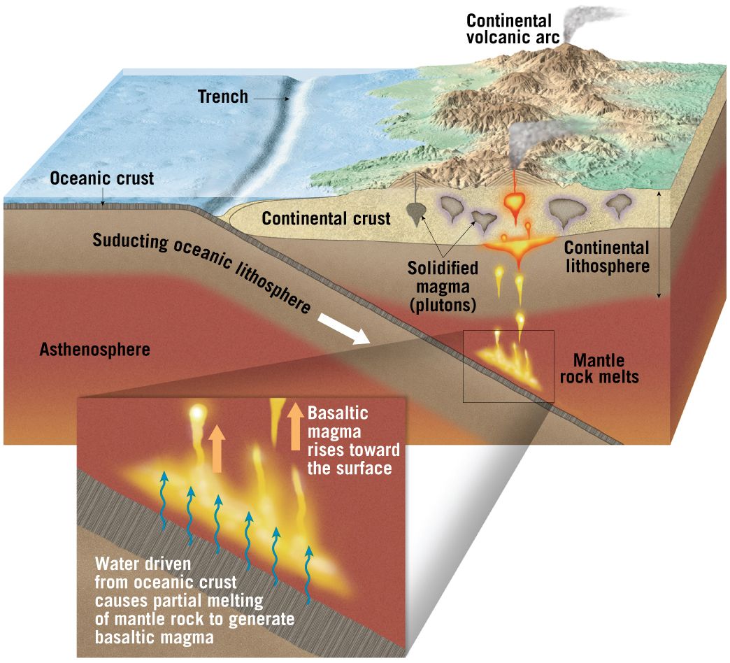
Generating Magma from Solid Rock
Adding water lowers melting temperature
Occurs at convergent boundaries

Slide 74
Generating Magma from Solid Rock
Mantle derived magma pools beneath crustal rocks
Heat from basaltic magma generates silica-rich magma via melting of continental crust
Also occurs during continental collisions

Slide 75
Focus Question 7.12
Explain how the geographic distribution of volcanic activity is related to plate tectonics.

Slide 76
Plate Tectonics and Volcanism
Most volcanoes are found near:
Ring of Fire around the Pacific Ocean
Mid-ocean ridges
Few are randomly distributed

Slide 77
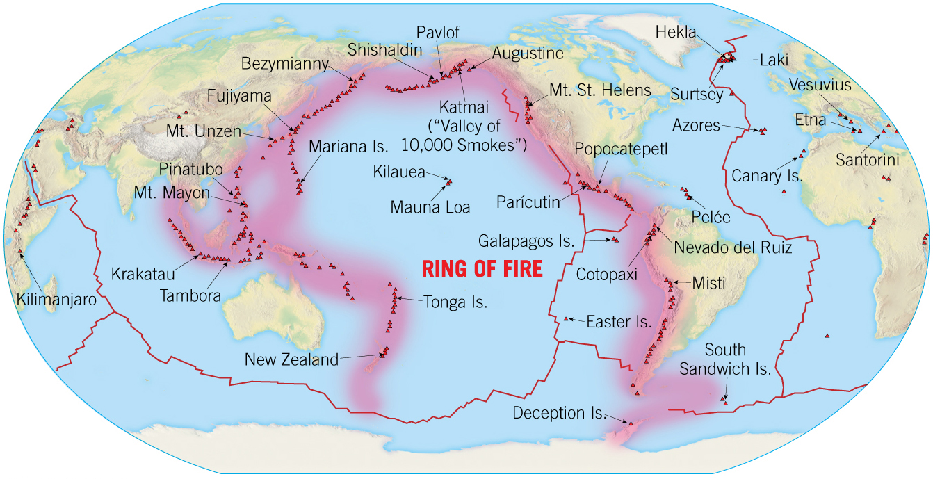
Plate Tectonics and Volcanism

Slide 78
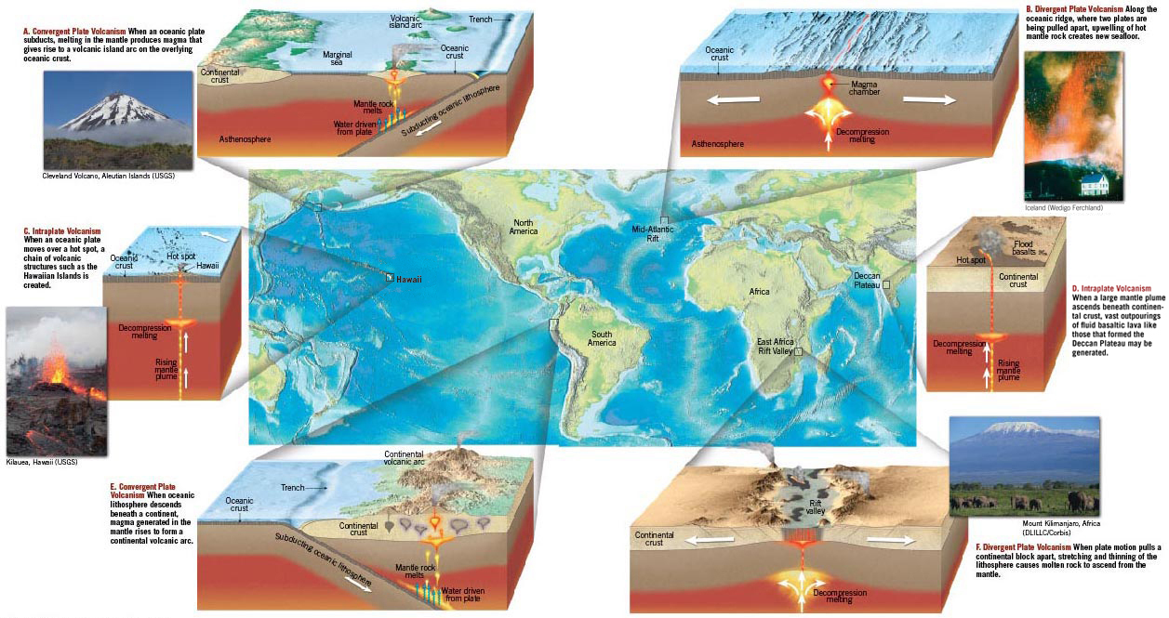
Plate Tectonics and Volcanism

Slide 79
Plate Tectonics and Volcanic Activity
Intraplate volcanism
A mantle plume of hot material ascends to the surface

